Slide 1
Static and shared libraries

Slide 2
COntent

Slide 3

Object libraries
Object libraries
Compile each source file and produce corresponding object file
Link all these files with main to create the execution program
Or group these files and created object libraries
Two kind of types object libraries as static and shared

Slide 4


STATIC LIBRARIES
Archives
Building a single library file from multiple executables file object without recompile original source file
Can see contents static lib and reserve static lib back to file object
Static libraries has name form as libname.a
Option
r – insert an object file into the archive, replace previous object file if has same name
t – table of content, display content of archives
d – delete a module from a archives

Slide 5

Use static libraries
use static lib
Give name of static lib in link command
Place to standard directories searches by linker and then specify the libraries name use –l libname option
Place somewhere and directive the linker to by using –L /path_to_dir option

Slide 6

Linking process
Linker - ld
Invoked through gcc
Object file and libraries provided in a certain order on command-line from left to right
Linker maintain a symbol table that has two list
A list exported by all the objects and libraries encountered so far
A list of undefined symbols that the encountered object and libraries requested to import and not found yet
When the linker encounter a new object file, it looks at
The symbol it exports : these added to the list of exported symbol
If any symbol in undefined list, it removed from there because it has been found, if any symbol in exported list, it terminate with multiple definition error : two different object export the same simple and linker confused
The symbol it import , it added to the list of undefined symbols, unless it can be found in list of exported symbol
When the linker encounter a new libraries, it first look at the symbol it export
If any the symbol it exports are on undefined list, the object is added to the link and the next step executed, otherwise the next step skipped
If object added to link, it treat as described above, its undefined and export symbols added to symbol tables
Finally, if any of the objects in the library has been included in the link, the library rescanned again, it is possible that symbols imported by included object can be found in other objects within the libraries
When the linking finished, it lookup the symbol table. If any symbols remain in the undefined list, the linker throw an “undefined reference” error

Slide 7
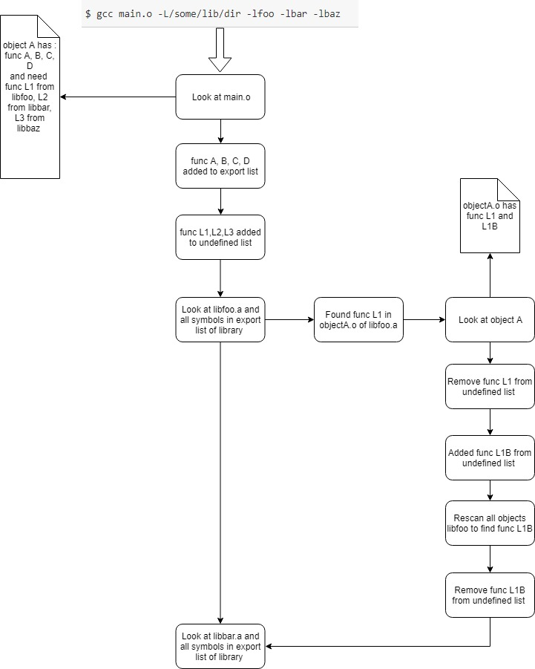
Linking process (2)
After linker looked at a library, it won’t look up again. Event if it exports symbol that may be need by some later library
As an library is examined, an object file within it can be lelf out of the link if it does provide symbols the symbol table need
An object file use function strlen, linker will load strlen.o will be taken into the link from libc.a, this called an-object-per-function and keep the execution bin small
If object or library AA need a symbol from library BB then AA should come before library BB in the command line invocation of linker

Slide 8
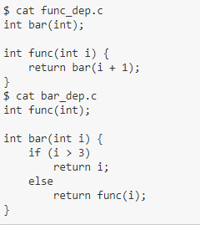
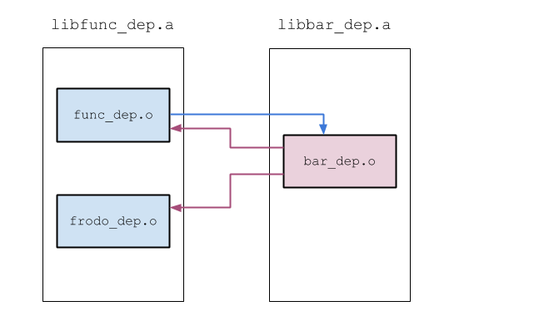
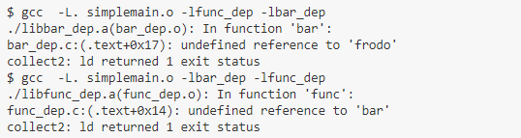

Circular dependency
what happens if AA needs a symbol from BB, but BB also needs a symbol from AA

Slide 9
Linker flags to solve
--start-group archive –end-group
Linker research all lib to find all symbols in undefined list
Cost to performance but it cheaps

Slide 10
Overview shared libraries
Disadvantages of static lib
Disk space wasted to storing multiple copies of the same object modules
If several difference programs using the same modules are running at the same time, each hold a copies of object modules in memory, it increase RAM program consumes
If a change require in lib, all executables use that module must be relinked
Advantages and disadvantages of shared lib
Program size is small but program use shared lib take longer to start
Because separation between program and shared lib, then when function in lib change, we don’t need relink program, just update shared lib but believe me, something it is inconvenient for programmer
Shared lib more complex than static and require more registers to run, it also require object file compile with Position Independent Code
Symbol relocation must be performed in run time

Slide 11


Create and use shared libraries
Use option –fPIC to build object file and –shared to build shared lib
Shared lib has prefix lib and the suffix .so
Unlike static lib, it is not possible to add and remove individual object from a previously built shared library
Position Independent Code
This option change the way the compiler generates code for operations (access global, static variables …), allow the code to be located at any virtual address at run time
This is necessary for shared mem since there no way to know where shared lib code will be located in memory
Verify by check GLOBAL_OFFSET_TABLE_

Slide 12


Use a shared libraries
A program maintain a shared library dependencies as dynamic dependency list
At runtime dynamic linker will find corresponding shared library file for program
In linux its name /lib/ld-linux.so.2
Dynamic linker exanimate dynamic dependency list and find shared lib in /usr/lib or /lib or user-defined directory
User-defined directory shared lib notify by LD_LIBRARY_PATH

Slide 13



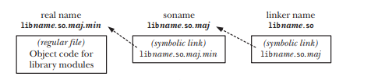

Shared lib soname
Realname vs soname and vs linkername
Soname as alias realname and use for linker
Option –soname pass to linker
Check soname with objectdump and readelf
Create soft-link between real-name and soname

Slide 14
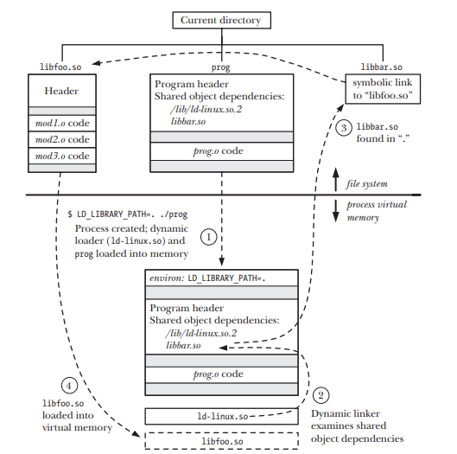
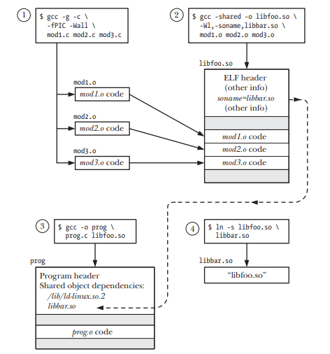
Share lib linking process and execution of program that load shared lib review

Slide 15

Useful tool for working with STATIC AND shared libs
ldd command
List dynamic dependencies and all shared lib that a program required to run
objdump and readelf command
To find symbol undefined ref
Merge two static libs into one
Provide a lot of information
nm command
To find where is one function located
Provide a lot of information

Slide 16


Shared Library Versions and Naming Conventions
Minor versions and major version
Differ but compatible or incompatible
The semantics of each public function and variables unchanges
Same argument list
Same effect and result to global variables
Same result value of all funcs
No have func or variables is removed
Structures allocated and exported unchanged but some cases we can added some additional field to structures
Form libname.so.major-id.minor-id format

Slide 17


Install AND update share lib
Standard libraries directory
/usr/lib - Most standard libraries directory
/lib - Use for system startup
/usr/local/lib - Nonstandard
LD_PATH_LIBRARY
ldconfig command
Build /etc/ld.so.cache from search a standard set of directory /usr/lib, /lib and dir in /etc/ld.so.conf
Exminates the lastest major/minor version to find embedded soname and create relative symbollink for each soname
We should run ldconfig each time we update new shared lib
Ldconfig –p to show cache and –v to show command output

Slide 18

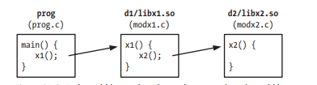




Specifying Library Search Directories by rpath

Slide 19
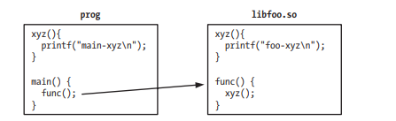

Finding Shared Libraries at Run Time
Dynamic linker searches for the shared lib using following order:
DT_RPATH (rpath) first
LD_LIBRARY_PATH
DT_RUNPATH
/etc/ld.so.cache
/lib and /usr/lib
Runtime symbol resolution
Global symbol reference
A definition of a global symbol in the main program override a definition in a library
If a global symbol is defined in multiple libraries, then a reference to symbol is bound to first definition found by scanning libraries in the lelf-to-right order in which they were listed on static link command line

Slide 20
Using a Static Library Instead of a Shared Library

